Slide 1
Object Oriented

Slide 2
Object
What is Object in Computer Programing
What is Object in Real World

Slide 3
Object in Real Life
Object is a thing
So is apple an object in real life?
Is desk?
This Laptop?
A mug?
They are all objects, these are all things.

Slide 4
We understand that objects are separate from one another. They have their own existence, their own identity(object name) that is independent of other objects. This is a Laptop, and this is a Laptop, but they are not the same Laptop, they are not the same object. They are different objects, they have their own identity.
We know that objects have Attribute (Variable)
A Laptop can be Open or Close.
An apple can be green or red,
A lamp can be off or on.
A mug can be full or empty.
These are the attributes of any object, things like color, weight, and size. They describe the current state of an object and the state of one object is independent of another. We turn one lamp off, it does not turn all the lamps in the world off.

Slide 5
And most objects have multiple attributes. A mug can be full or empty but at the same time it could be black or white or some other color. It could be large or small.
In real world objects have behavior (Methods)
a telephone can ring,
an airplane can fly,
A behavior is specific to the type of object
an apple does not ring,
a telephone does not fly.
But those three things, identity, attributes, and behavior are the same three things that describe an object in an object-oriented programming language.

Slide 6
Object in Computer Programing
Objects have identity separate from other objects. They also have their own attributes. Information that describes their current state, and they have their own behavior, things they can do.
Now while in the real world we tend to only use the word object for things we can see and touch, but in computing we can take it further.
Sure, in a computer program, we often have objects that represent real world items like car, house, apple, but also a date could be an object, a time, abank account could be an object, and you can't touch and hold a bank account in real life.

Slide 7
But it is still a well-defined idea, and even in real life it meets our definition of object.
It has identity. One bank account is separate from another bank account.
It has attributes or data that describe its current state. An account number, a balance, an account holder name.
It has behavior. You can deposit to a bank account, you can withdraw from it, you can open it or close it.
And just as they don't have to be physical items, objects in a computer program are not just the things with a visual appearance on the computer screen

Slide 8
And the entire point of Object-Oriented Design is not about objects, it's about classes because we use classes to create objects.

Slide 9
What is Class?

Slide 10
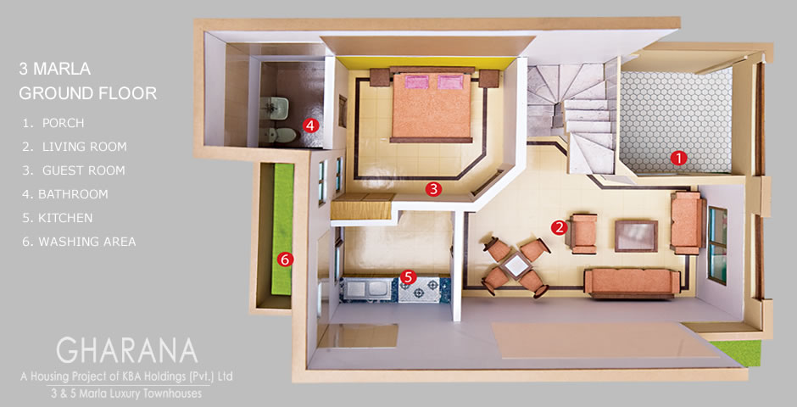
A class is a blueprint.
The blueprint example is. If you want to build a house, you make a blueprint (Map) first. It describes everything about how that house will be built, but it isn't the house. You then use that blueprint to build the house

Slide 11
We write the class then use the class to create the object. And just as we could use the same blueprint(Map) to build one, two, or a hundred houses, we can define the class once and then create a thousand objects based on that one class, but the class comes first. The class comes first, that's what we write
A class has a name, attributes and behavior

Slide 12
Creating a Class
Name(Type): What is it?
Employee, BankAccount, Student, MarkAttendence
Attribute(Properties/Data/Variable Name): What Describe it?
Width, Height, Amount, Roll#, IsPresent
Behaviour(Operation/Method): What can it do?
Open, Close, WithDraw, Search, Delete, Insert

Slide 13
Class/Objects
If we create a BankAccount class?
What Attribute & Behaviour we create?

Slide 14
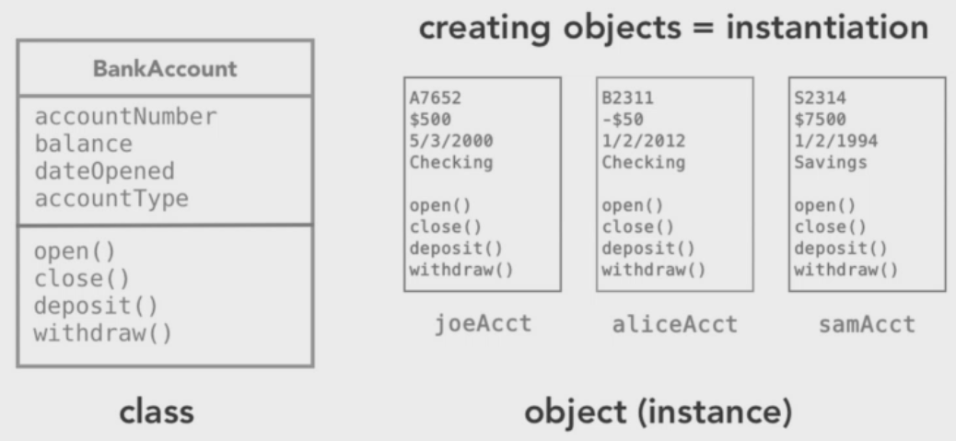
The class says that each object has an accountNumber, but it doesn't say what the account number is.
It says each object will have a balance, but it doesn't say what that balance is.
And behavior might say we have got open, closed, and deposit and withdraw.
After writing the class, we can then create objects based on that class

Slide 15
Create Object
Means we are creating instances of a class,
each object is an instance of a particular class.
Now each instance/object-- whether one, two, or a thousand--has its own identity independent from other objects and its own data and its own behavior. So the class says that each object has a balance, but the individual objects say, well, my balance is 500 or -50 or 7500.

Slide 17
Define Fields in a class
A class can contain any of the following variable types.
Local variables. variables defined inside methods, constructors or blocks are called local variables. The variable will be declared and initialized within the method and the variable will be destroyed when the method has completed.
Instance variables or Member variable or Fields or Attributes . Instance variables are variables within a class but outside any method. These variables are instantiated when the class is loaded. Instance variables can be accessed from inside any method, constructor or blocks of particular class. Instance variables stores the state of the object. Each class would have its own copy of the variable.
private int abc; //fields variables
public int abc //member variables
Class variables or static variable. Class variables are variables declared with in a class, outside any method, with the static keyword.
public static int abc;

Slide 18
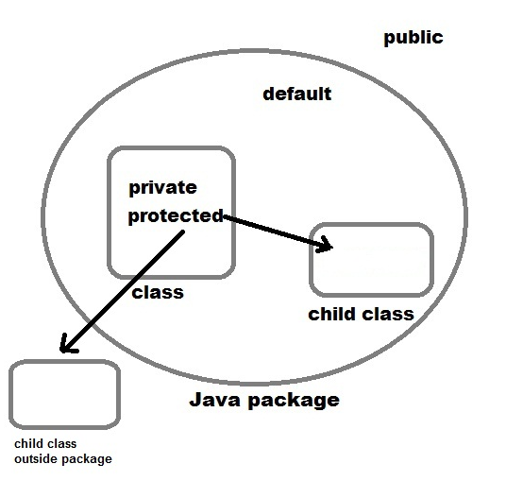
Access Modifier
Default: has scope only inside the package.
Public: scope is visible every where
Protected: has scope with in the package and all subclasses.
Private: has scope with in the class

Slide 19
Constructor
Every class has a constructor. If we do not explicitly write a constructor for a class the java compiler builds a default constructor for that class.
The main rule of constructors is that they should have the same name as the class. A class can have more than one constructor.
Constructor is a special type of method which have no return type
constructors for initializing new objects or declarations for the fields

Slide 20
class Box {
double width;
double height;
double depth;
public static void main(String args[]) {
Box mybox = new Box();
double vol;
mybox.width = 10;
mybox.height = 20;
mybox.depth = 15;
vol = mybox.width * mybox.height * mybox.depth;
System.out.println("Volume is " + vol);
}
}
The new Operator dynamically allocates memory for an Object

Slide 21
class Box {
double width;
double height;
double depth;
}
class BoxDemo {
public static void main(String args[]) {
Box mybox1 = new Box();
Box mybox2 = new Box();
mybox1.width = 10;
mybox1.height = 20;
mybox1.depth = 15;
mybox2.width = 3;
mybox2.height = 6;
mybox2.depth = 9;
vol = mybox1.width * mybox1.height * mybox1.depth;
System.out.println("Volume is " + vol);
vol = mybox2.width * mybox2.height * mybox2.depth;
System.out.println("Volume is " + vol);
}
}

Slide 22
class Box {
double width;
double height;
double depth;
Box() {
System.out.println("Constructing Box");
width = 10;
height = 10;
depth = 10;
}
}
class BoxDemo6 {
public static void main(String args[]) {
Box mybox1 = new Box();
double vol;
vol = mybox1.width * mybox1.height * mybox.1depth;
System.out.println("Volume is " + vol);
}
}

Slide 23
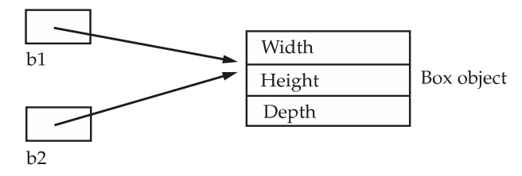
Assigning Object Reference Variables
Box b1 = new Box();
Box b2 = b1
That is, you might think that b1 and b2 refer to separate and distinct objects. However, this would be wrong. Instead, after this fragment executes,b1 and b2 will both refer to the same object. The assignment of b1 to b2 did not allocate any memory or copy any part of the original object. It simply makes b2 refer to the same object as does b1. Thus, any changes made to the object through b2 will affect the object to which b1 is referring, since they are the same object
Although b1 and b2 both refer to the same object, b1 from the original object without affecting the object b2. For example:
Box b1 = new Box();
Box b2 = b1;
// ...
b1 = null;
Here,b1 has been set to null , but b2 still points to the original object. When you assign one object reference variable to another object reference variable, you are not creating a copy of the object, you are only making a copy of the reference.

Slide 24
Introducing Methods
Although it is perfectly fine to create a class that contains only data, it rarely happens. Most of the time you will use methods to access the instance variables defined by the class
classes usually consist of two things: instance variables and methods
This is the general form of a method:
modifier type name(parameter-list) Exception{
// body of method
}
Modifiers—such as public, private, protected
The return type—the data type of the value returned by the method, or void if the method does not return a value.
The method name—any name .
The parameter list in parenthesis—a comma-delimited list of input parameters, preceded by their data types, enclosed by parentheses, (). If there are no parameters, you must use empty parentheses
An exception—is an optional to be discussed later
The method body, enclosed between braces—the method's code, including the declaration of local variables, goes here

Slide 25
class Box {
double width;
double height;
double depth;
void volume() {
System.out.print("Volume is ");
System.out.println(width * height * depth);
}
}
class BoxDemo3 {
public static void main(String args[]) {
Box mybox1 = new Box();
Box mybox2 = new Box();
mybox1.width = 10;
mybox1.height = 20;
mybox1.depth = 15;
mybox2.width = 3;
mybox2.height = 6;
mybox2.depth = 9;
mybox1.volume();
mybox2.volume();
}
}

Slide 26
Returning a Value
completes all the statements in the method,
reaches a return statement
You declare a method's return type in its method declaration. Within the body of the method, you use the return statement to return the value.
Any method declared void doesn't return a value. It does not need to contain a return statement, but it may do so. In such a case, a return statement can be used to branch out of a control flow block and exit the method and is simply used like this:
return;
If you try to return a value from a method that is declared void, you will get a compiler error.
Any method that is not declared void must contain a return statement with a corresponding return value, like this:
return returnValue;
The data type of the return value must match the method's declared return type; you can't return an integer value from a method declared to return a boolean.

Slide 27
class Box {
double width;
double height;
double depth;
double volume() {
return width * height * depth;
}
}
class BoxDemo4 {
public static void main(String args[]) {
Box mybox1 = new Box();
Box mybox2 = new Box();
double vol;
mybox1.width = 10;
mybox1.height = 20;
mybox1.depth = 15;
mybox2.width = 3;
mybox2.height = 6;
mybox2.depth = 9;
vol = mybox1.volume();
System.out.println("Volume is " + vol);
vol = mybox2.volume();
System.out.println("Volume is " + vol);
}
}

Slide 28
Adding a Method That Takes Parameters
Parameters allow a method to be generalized
Here is a method that returns the square of the number 10
int square()
{
return 10 * 10;
}
While this method does, indeed, return the value of 10 squared, its use is very limited. However, if you modify the method so that it takes a parameter, as shown next, then you can make square( ) much more useful
int square(int i)
{
return i * i;
}

Slide 29
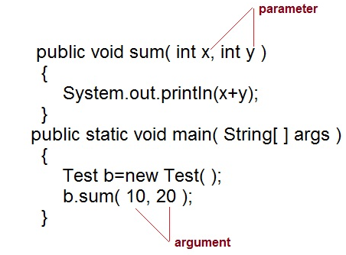

Slide 30
Argument Passing
there are two ways that a computer language can pass an argument. call-by-value and call-by-reference
call-by-value:- copy of an argument value is pass to a method. Changes made to the argument value inside the method will have no effect on the argument
call-by-reference reference of an argument is pass to a method. Any changes made inside the method will affect the argument value.
In java you pass a data type to a method it is pass-by-value when you pass an object to a method it is pass-by-reference

Slide 31
CallByValue
class CallByValue {
public static void main(String args[]) {
Test ob = new Test();
int a = 15, b = 20;
System.out.println("a and b before call: " +
a + " " + b);
ob.meth(a, b);
System.out.println("a and b after call: " +
a + " " + b);
}
}
class Test {
void meth(int i, int j) {
i *= 2;
j /= 2;
}
}
The output from this program is shown here:
a and b before call: 15 20
a and b after call: 15 20

Slide 32
CallByReference
class CallByRef {
public static void main(String args[]) {
Test ob = new Test(15, 20);
System.out.println("ob.a and ob.b before call: " + ob.a + " " + ob.b);
ob.meth(ob);
System.out.println("ob.a and ob.b after call: " +ob.a + " " + ob.b);
}
}
This program generates the following output:
ob.a and ob.b before call: 15 20
ob.a and ob.b after call: 30 10
class Test {
int a, b;
Test(int i, int j) {
a = i;
b = j;
}
void meth(Test o) {
o.a *= 2;
o.b /= 2;
}
}

Slide 33
Parameterized Constructor
class Box {
double width;
double height;
double depth;
Box(double w, double h, double d) {
width = w;
height = h;
depth = d;
}
double volume() {
return width * height * depth;
}
}
class BoxDemo7 {
public static void main(String args[]) {
Box mybox1 = new Box(10, 20, 15);
Box mybox2 = new Box(3, 6, 9);
double vol;
vol = mybox1.volume();
System.out.println("Volume is " + vol);
vol = mybox2.volume();
System.out.println("Volume is " + vol);
}
}

Slide 34
Returning Objects
A method can return any type of data, including class types that you create. For example, in the following program, the incrByTen( ) method returns an object in which the value of a is ten greater than it is in the invoking object

Slide 35
class Test {
int a;
Test(int i) {
a = i;
}
Test incrByTen() {
Test temp = new Test(a+10);
return temp;
}
}
class RetOb {
public static void main(String args[]) {
Test ob1 = new Test(2);
Test ob2;
ob2 = ob1.incrByTen();
System.out.println("ob1.a: " + ob1.a);
System.out.println("ob2.a: " + ob2.a);
ob2 = ob2.incrByTen();
System.out.println("ob2.a after second increase: "+ ob2.a);
}
}

Slide 36
Define Last Example
The output generated by this program is shown here:
ob1.a: 2
ob2.a: 12
ob2.a after second increase: 22
As you can see, each timeincrByTen( ) is invoked, a new object is created, and a reference to it is returned to the calling routine. The preceding program makes another important point

Slide 37
“static” Keyword = Class Variables
Variables can be declared with the “static” keyword. Example:
static int y = 0;
When a variable is declared with the keyword “static”, its called a “class variable”. All instances share the same copy of the variable. A class variable can be accessed directly with the class, without the need to create a instance.
A static variable call any method or constructor

Slide 38
class T2 {
int x = 0; // instance variable
static int y = 0; // class variable
void setX (int n) { x = n;}
void setY (int n) { y = n;}
int getX () { return x;}
int getY () { return y;}
}
class T1 {
public static void main(String[] arg) {
T2 b1 = new T2();
T2 b2 = new T2();
b1.setX(5);
b2.setX(10);
b1.setY(15);
b2.setY(20);
// each b1 and b2 has separate copies of x
System.out.println( b1.getX() );
System.out.println( b2.getX() );
// both have same value
System.out.println( b1.getY() );
System.out.println( b2.getY() );
// class variable can be used directly without a instance of it.
//(if changed to T2.x, it won't compile)
System.out.println( T2.y );
T2.y = 7;
System.out.println( T2.y );
// class variable can be manipulated thru methods as usual
b1.setY(T2.y+1);
System.out.println( b1.getY() );
}
}

Slide 39
Output Of Last Program
5
10
20
20
20
7
8

Slide 40
Instance Metod vs Class Methods
Methods can also be declared with the keyword “static”. When a method is declared static, it can be used without having to create a object first. For example, you can define a collection of math functions in a class, all static, using them like functions.
Methods declared as static have several restrictions:
■ They can only call other static methods.
■ They must only access static data.
■ They cannot refer to this or super in any way. (The keyword super relates to inheritance and is described Later.)

Slide 41
// A class with a static method
class T2 {
static int triple (int n) {
return 3*n;
}
}
class T1 {
public static void main(String[] arg) {
// calling static methods without creating a instance
System.out.println( T2.triple(4) );
// calling static methods thru a instance is also allowed
T2 x1 = new T2();
System.out.println( x1.triple(5) );
}
}
Methods declared with “static” keyword are called “class methods”. Otherwise they are “instance methods”.

Slide 42
Static Methods Cannot Access Non-Static Variables Methods declared with “static” cannot access variables declared without “static”. The following gives a compilation error, unless x is also static.
class T2 {
int x = 3;
static int returnIt () {
return x;
}
}
class T1 {
public static void main(String[] arg) {
System.out.println( T2.returnIt() );
}
}

Slide 43
static variables, methods, and blocks
class UseStatic {
static int a = 3;
static int b;
static void meth(int x) {
System.out.println("x = " + x);
System.out.println("a = " + a);
System.out.println("b = " + b);
}
static {
System.out.println("Static block initialized.");
b = a * 4;
}
public static void main(String args[]) {
meth(42);
}
}

Slide 44
Define last program
Out put is
Static block initlize
X=42
a=3
b=12
The UseStaticclass is loaded, all of the static statements are run. First, a is set to 3, then the static block executes (printing a message), and finally, b is initialized to a * 4 or 12. Then main( )is called, which callsmeth( ), passing 42 to x. The threeprintln( )statements refer to the two static variables a and b, as well as to the local variable x.

Slide 45
Inner Class
An instance of InnerClass can exist only within an instance of OuterClass and has direct access to the methods and fields of its enclosing instance. The next figure illustrates this idea.
class OuterClass {
...
class InnerClass {
...
}
}

Slide 46
class Outer {
int outer_x = 100;
void test() {
Inner inner = new Inner();
inner.display();
}
// this is an inner class
class Inner {
void display() {
System.out.println("display: outer_x = " + outer_x);
}
}
}
class InnerClassDemo {
public static void main(String args[]) {
Outer outer = new Outer();
outer.test();
}
}
OR
class InnerClassDemo {
public static void main(String args[]) {
Outer outer = new Outer();
Outer.Inner innerObject = outer.new Inner();
outer.test();
innerObject.display();
}
}

Slide 47
class Outer {
int outer_x = 100;
void test() {
Inner inner = new Inner();
inner.display();
}
// this is an inner class
class Inner {
int y = 10; // y is local to Inner
void display() {
System.out.println("display: outer_x = " + outer_x);
}
}
void showy() {
System.out.println(y); // error, y not known here!
}
}
class InnerClassDemo {
public static void main(String args[]) {
Outer outer = new Outer();
outer.test();
}
}

Slide 48
class Outer {
int outer_x = 100;
void test() {
for(int i=0; i<10; i++) {
class Inner {
void display() {
System.out.println("display: outer_x = " + outer_x);
}
}
Inner inner = new Inner();
inner.display();
}
}
}
class InnerClassDemo {
public static void main(String args[]) {
Outer outer = new Outer();
outer.test();
} }

